Slide 1
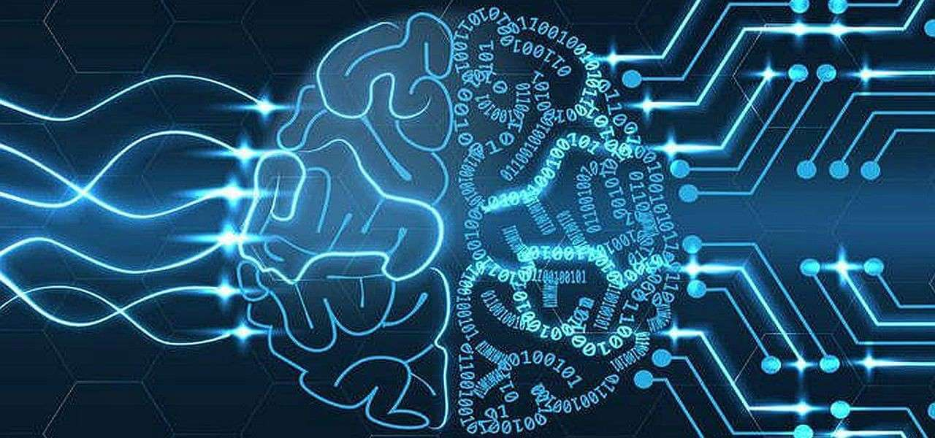
Brain Tumor Detection Through Image Segmentation Using Deep Learning Approach

Slide 2
AUTHORS
Name | ID
Nazmunnahar Amie | 19202103233
Al Mahabub Nur | 19202103231
Hossain Bin Walid | 19202103213
Sadia Islam | 19202103387
Faria Rahman Nourin | 19202103388
Supervised by
T. M. Amir – Ul – Haque Bhuiyan
Assistant Professor
Department of Computer Science and Engineering
Bangladesh University of Business and Technology

Slide 3
Topics we are going to discuss
Introduction
Objectives
Contributions
Background and Related Works
Dataset
Proposed Methodology
Proposed Model
Evaluation Criteria
Results Based on Data Visualisation
Comparison With Other Models
Limitations
Future Works
Conclusion
References

Slide 4
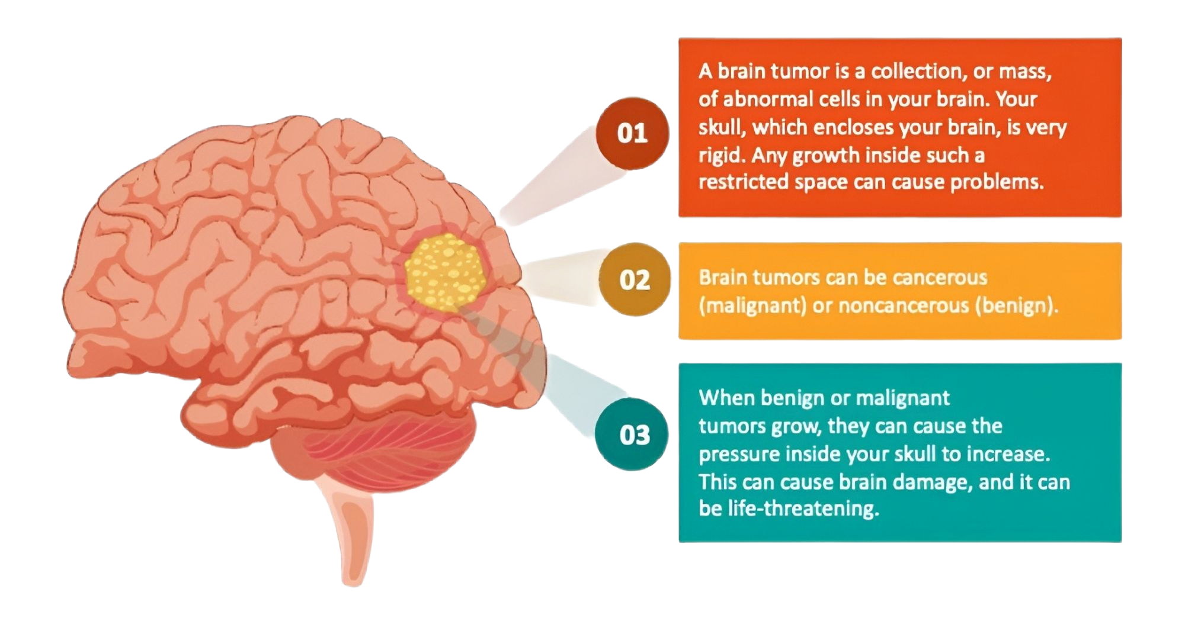
INTRODUCTION: WHAT IS BRAIN TUMOR?

Slide 5
OBJECTIVES
Segmented the image properly
Detect the affected tumor cell from segmented image within efficient way.
To construct a customized Unet Model that accurately categorize brain tumors from MRI images

Slide 6
CONTRIBUTIONS
Use efficient dataset preprocessing with OpenCV tools to make standard dataset.
Utilizing a customized Unet Architecture as proposed model to detect brain tumors efficiently
Apply color MRI brain datasets for evaluating model performance comparing existing models

Slide 7
BACKGROUND & RELATED WORKS
Ayadi et al. [1] developed a new deep CNN model for brain tumor classification using Radiopaedia. They achieved an overall accuracy of 93.71% after augmentation.
Rehman et al. [2] implemented a novel deep learning-based method for brain tumor detection and classification, utilizing a 3D Convolutional Neural Network with a pre-trained VGG19. Their model achieved an accuracy of 92.67% on the BraTS 2018 dataset.
Mahmud et al. [3] introduced a deep learning-based analysis for brain tumor detection using MRI images. Employing CNN architecture, achieving a maximum accuracy of 93.3%.
Shraddha et al. [4] presented a brain tumor detection method based on convolutional neural networks (CNNs). They achieved an accuracy of 87.42%.

Slide 8
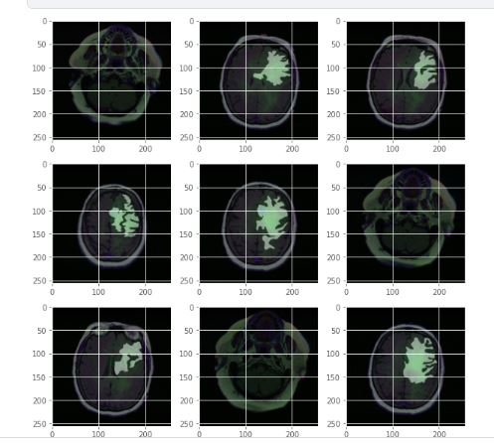
DATASET
Training Dataset sample
Class Name | Count
 | Train | Test | Validation
Tumor | 1555 | 216 | 389
No Tumor | 1273 | 177 | 319
Total | 2828 | 293 | 708

Slide 9
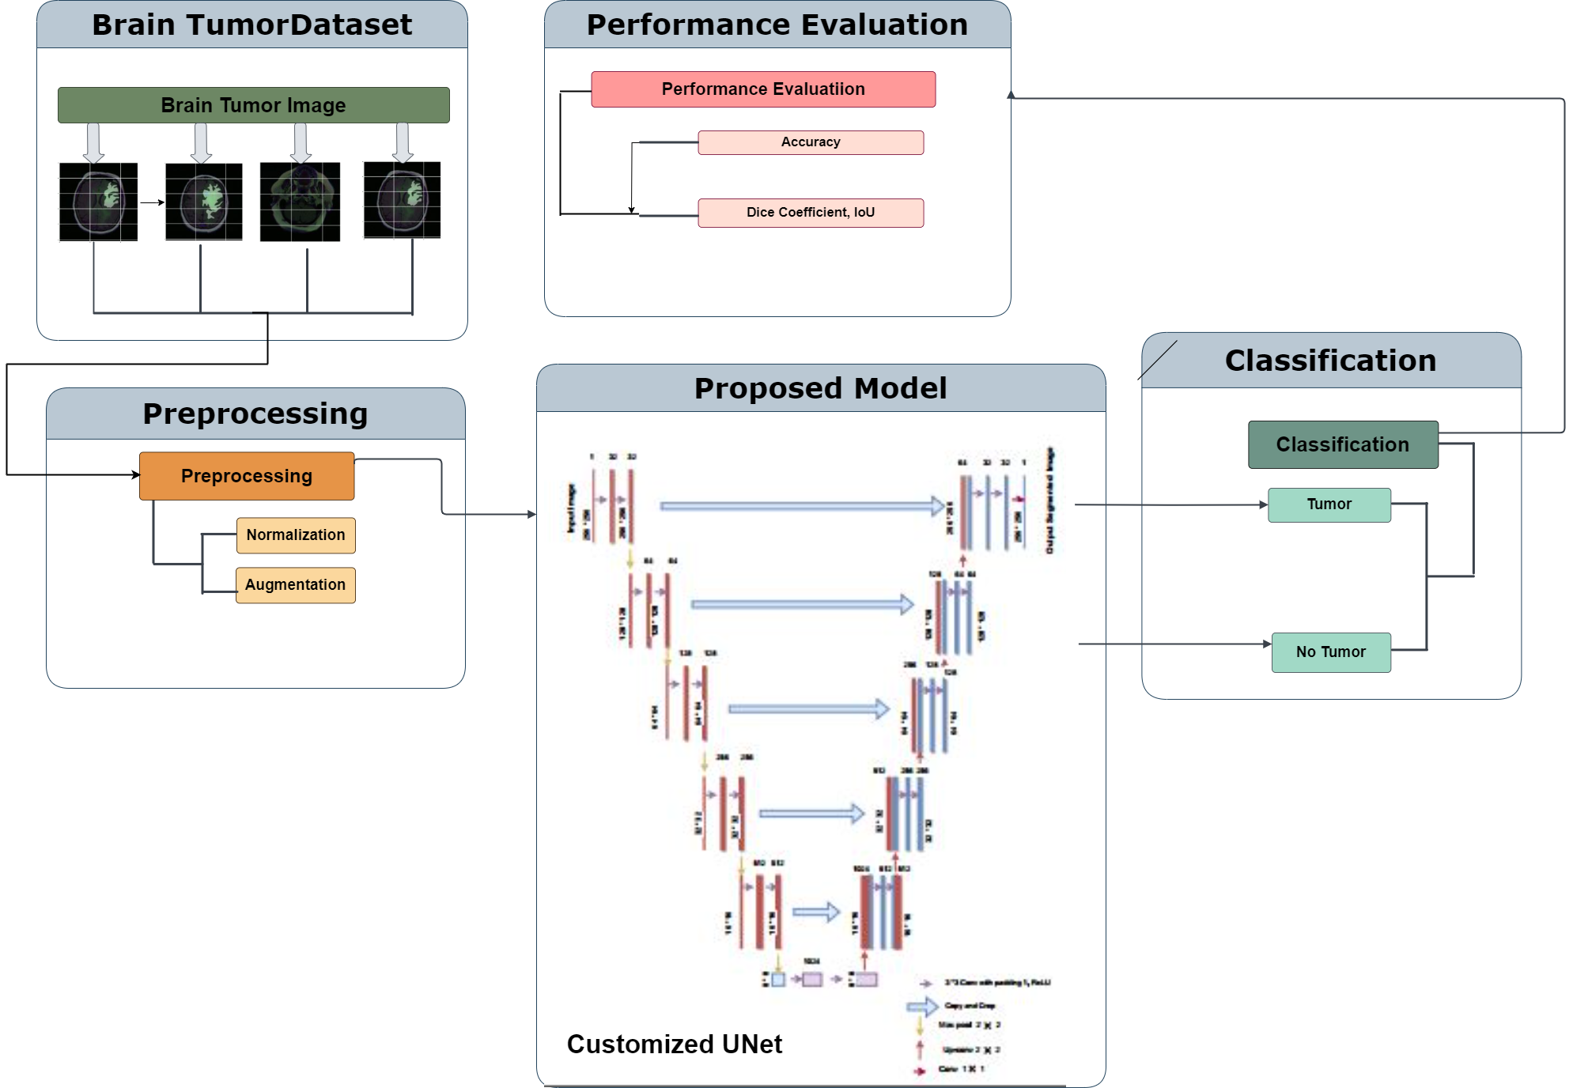
Proposed Methodology

Slide 10
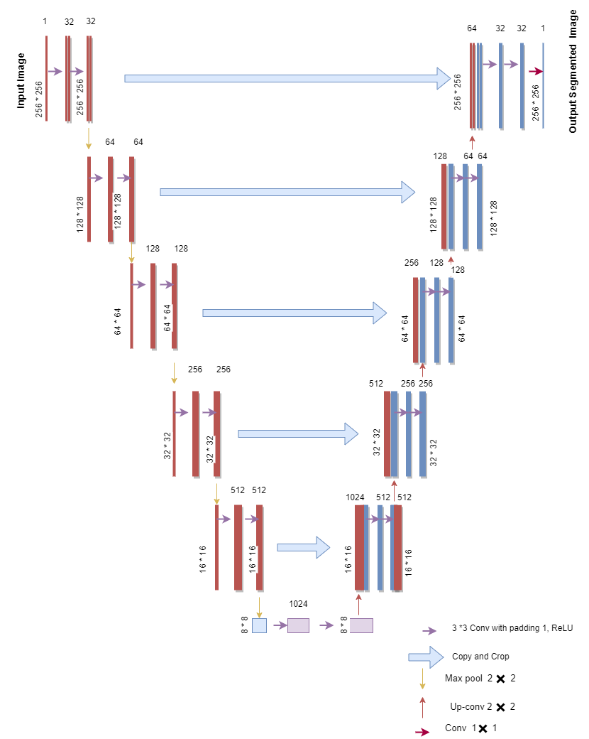
Proposed Customized Unet Model

Slide 11
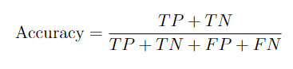
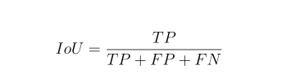
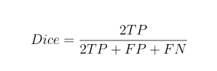
EVALUATION CRITERIA

Slide 12
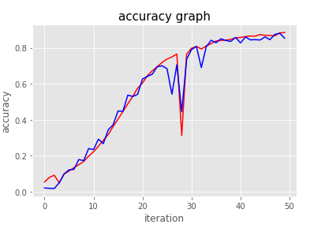
RESULTS BASED ON DATA VISUALISATION: Training Accuracy VS Validation Accuracy Curve
We conducted training using 50 epochs
On the 47th epoch:
Training accuracy was 95.80%
Validation accuracy was 95.78%

Slide 13
COMPARISON WITH OTHER MODELS
Author | Model | Accuracy
Ahmed et al.[6] | Ensembles of CNN | 57.1%
Ayadi et al. [1] | CNN | 93.71%
Rehman et al. [2] | CNN, VGG19 | 92.67%
Mahmud et al. [3] | CNN | 93.3%
Shraddha et al. [4] | CNN | 87.42%
Irmak et al.[5] | 25 layered CNN | 92.66%
Proposed Model | Customized Unet CNN | 95.78%
Comparison of our proposed model with some existing models

Slide 14
LIMITATIONS
The current model is limited to medical imaging datasets, thus there is a potential for enhanced performance with the inclusion of large datasets.
There are more than 120 types of brain tumor but we are only working with detection of brain tumor whether it happen or not with segmentation.

Slide 15
FUTURE WORKS
Explore the application of the current model to be able to work with large amount of 3D brain tumor datasets.
Expand the dataset to include a broader range of brain tumor classes, allowing the model to distinguish between a wider variety of clinical diseases.
Investigate the integration of new deep learning models into the methodology to further improve detection & classification accuracy and efficiency.

Slide 16
CONCLUSION
To train our customized model effectively, we needed a substantial number of instances.
We used techniques like normalization and augmentation to prepare the images for training. Augmentation involved actions like zooming, rotating, and flipping images, making our dataset larger and more diverse.
The pre-trained Unet model had knowledge about textures and shapes relevant to medical images. We added extra layers both in downsampling & upsampling to learn patterns specific to brain tumors, resulting in a high accuracy of 95.78% for our customize model.

Slide 17
REFERENCES
[1] W. Ayadi, W. Elhamzi, I. Charfi, and M. Atri, “Deep cnn for brain tumor classification,” Neural processing letters, vol. 53, pp. 671–700, 2021. [2] A. Rehman, M. A. Khan, T. Saba, Z. Mehmood, U. Tariq, and N. Ayesha, “Microscopic brain tumor detection and classification using 3d cnn and feature selection architecture,” Microscopy Research and Technique, vol. 84, no. 1, pp.133–149, 2021. [3] M. I. Mahmud, M. Mamun, and A. Abdelgawad, “A deep analysis of brain tumor detection from mr images using deep learning networks,” Algorithms, vol. 16, no. 4, p. 176, 2023. [3] S. S. More, M. A. Mange, M. S. Sankhe, and S. S. Sahu, “Convolutional neural network based brain tumor detection,” in 2021 5th International conference on intelligent computing and control systems (ICICCS). IEEE, 2021, pp. 1532–1538.
[4] E. Irmak, “Multi-classification of brain tumor mri images using deep convolutional neural network with fully optimized framework,” Iranian Journal of Science and Technology, Transactions of Electrical Engineering, vol. 45, no. 3, pp. 1015–1036, 2021.
[5] K. Ben Ahmed, L. O. Hall, D. B. Goldgof, and R. Gatenby, “Ensembles of convolutional neural networks for survival time estimation of high-grade glioma patients from multimodal mri,” Diagnostics, vol. 12, no. 2, p.345, 2022.
[6] K. Ben Ahmed, L. O. Hall, D. B. Goldgof, and R. Gatenby, “Ensembles of convolutional neural networks for survival time estimation of high-grade glioma patients from multimodal mri,” Diagnostics, vol. 12, no. 2, p. 345, 2022.

Slide 18
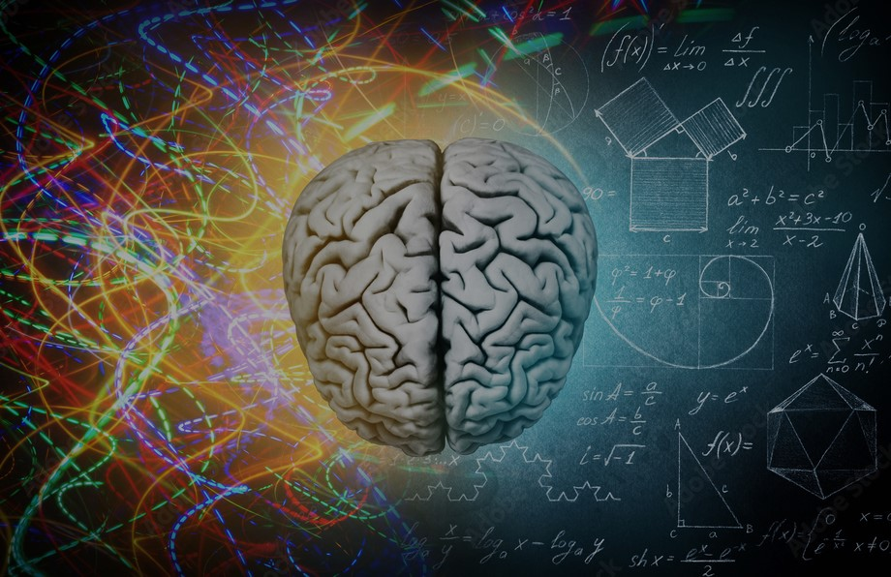
THANK YOU !

